Slide 1

EFI_PEI_SERVICES
Notes:
Types of Documents: AMI Internal Only (INT)
Audience: AMI employees only
Cannot be distributed to any customer under NDA
Cannot be distributed as a public document
Found on internal servers only
Examples:
Implementation guides
Product plans & specifications
Chipset Support Package (CSP) specification
Employee training

Slide 2
Agenda
EFI_PEI_SERVICES
PPI Services
Boot Mode Services
HOB Services
PEI Memory Services
Reset Services
Reference documents:
Pre-EFI Initialization Core Interface Specification Version 0.9

Slide 3
EFI_PEI_SERVICES
Firmware Volume Functions
EFI_PEI_FFS_FIND_NEXT_VOLUME | FfsFindNextVolume
EFI_PEI_FFS_FIND_NEXT_FILE | FfsFindNextFile
EFI_PEI_FFS_FIND_SECTION_DATA | FfsFindSectionData
PEI Memory Functions
EFI_PEI_INSTALL_PEI_MEMORY | InstallPeiMemory
EFI_PEI_ALLOCATE_PAGES | AllocatePages
EFI_PEI_ALLOCATE_POOL | AllocatePool
EFI_PEI_COPY_MEM | CopyMem
EFI_PEI_SET_MEM | SetMem
Status Code
EFI_PEI_REPORT_STATUS_CODE | ReportStatusCode
Reset
EFI_PEI_RESET_SYSTEM | ResetSystem
The PEI Services Table includes a list of function pointers in a table.
Struct
EFI_TABLE_HEADER | Hdr
PPI Functions
EFI_PEI_INSTALL_PPI | InstallPpi
EFI_PEI_REINSTALL_PPI | ReInstallPpi
EFI_PEI_LOCATE_PPI | LocatePpi
EFI_PEI_NOTIFY_PPI | NotifyPpi
Boot Mode Functions
EFI_PEI_GET_BOOT_MODE | GetBootMode
EFI_PEI_SET_BOOT_MODE | SetBootMode
HOB Functions
EFI_PEI_GET_HOB_LIST | GetHobList
EFI_PEI_CREATE_HOB | CreateHob

Slide 4
EFI_PEI_SERVICES
Parameters
Hdr | The table header for the PEI Services Table.
InstallPpi | Installs an interface in the PEI PEIM-to-PEIM Interface (PPI) database by GUID.
ReInstallPpi | Reinstalls an interface in the PEI PPI database by GUID.
LocatePpi | Locates an interface in the PEI PPI database by GUID.
NotifyPpi | Installs the notification service to be called back upon the installation or reinstallation of a given interface.
GetBootMode | Returns the present value of the boot mode.
SetBootMode | Sets the value of the boot mode.
GetHobList | Returns the pointer to the list of Hand-Off Blocks (HOBs) in memory.
CreateHob | Abstracts the creation of HOB headers.

Slide 5
EFI_PEI_SERVICES
Parameters
FfsFindNextVolume | Discovers instances of firmware volumes in the system.
FfsFindNextFile | Discovers instances of firmware files in the system.
FfsFindSectionData | Searches for the next matching file in the Firmware File System (FFS) volume.
InstallPeiMemory | Registers the found memory configuration with the PEI Foundation.
AllocatePages | Allocates memory ranges that are managed by the PEI Foundation.
AllocatePool | Frees memory ranges that are managed by the PEI Foundation.
CopyMem | Copies the contents of one buffer to another buffer.
SetMem | Fills a buffer with a specified value.
ReportStatusCode | Provides an interface that a PEIM can call to report a status code.
ResetSystem | Resets the entire platform.

Slide 6
EFI_PEI_SERVICES
Introduction
A PEI Service is defined as a function, command, or other capability created by the PEI Foundation
during a phase that remains available after the phase is complete. Because the PEI phase has no
permanent memory available until nearly the end of the phase, the range of PEI Foundation
Services created during the PEI phase cannot be as rich as those created during later phases.
The following are PEI Services, which are described in this section:
PPI Services | Manages PEIM-to-PEIM Interface (PPIs) to facilitate intermodule calls between PEIMs. Interfaces are installed and tracked on a database maintained in temporary RAM.
Boot Mode Services | Manages the boot mode (S3, S5, normal boot, diagnostics, etc.) of the system.
HOB Services | Creates data structures called Hand-Off Blocks (HOBs) that are used to pass information to the next phase of the Framework.
Firmware Volume Services | Walks the Firmware File System (FFS) in firmware volumes to find PEIMs and other firmware files in the flash device.
PEI Memory Services | Provides a collection of memory management services for use both before and after permanent memory has been discovered.
Status Code Services | Provides common progress and error code reporting services (for example, port 080h or a serial port for simple text output for debug).
Reset Services | Provides a common means by which to initiate a warm or cold restart of the system.

Slide 7
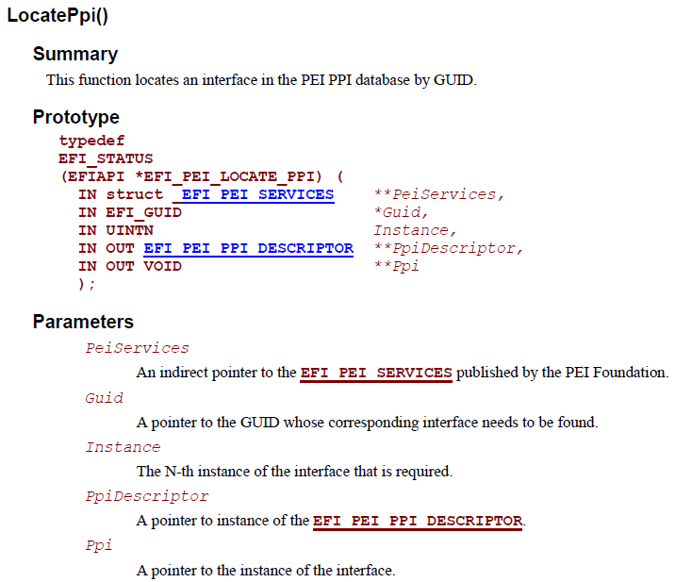
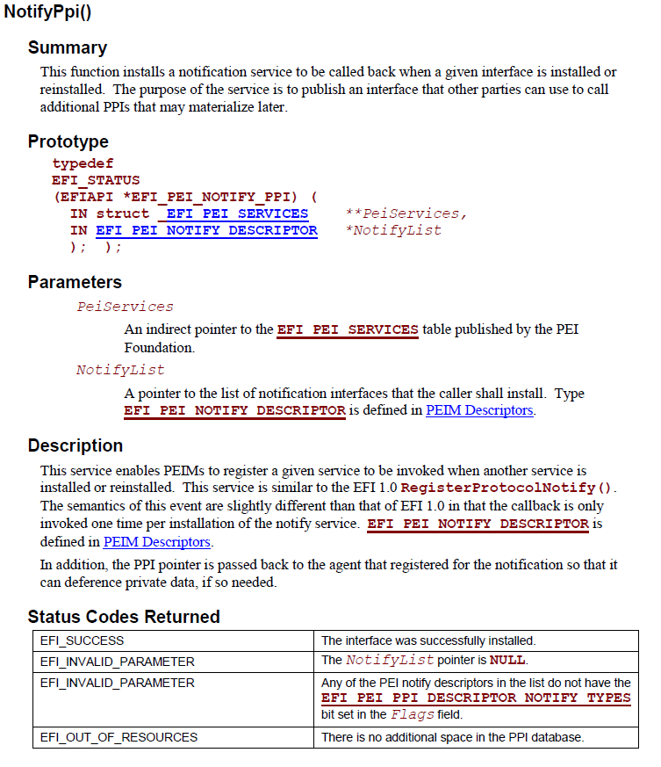
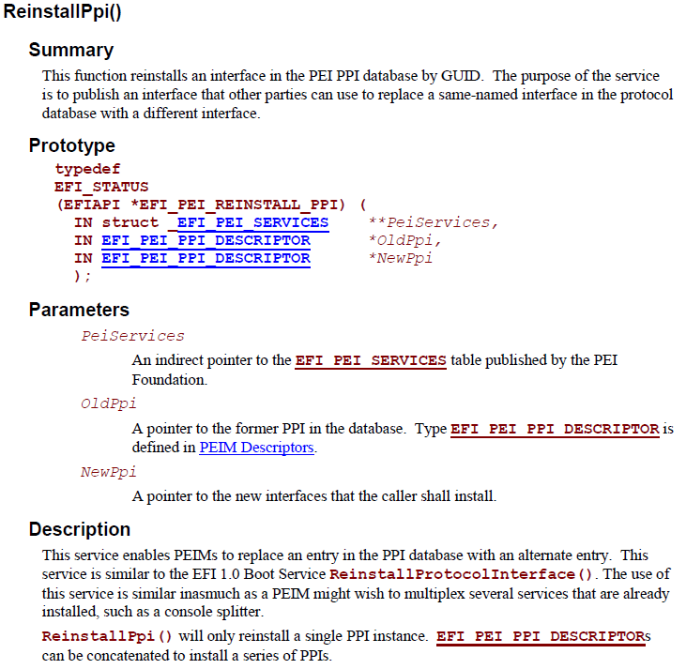
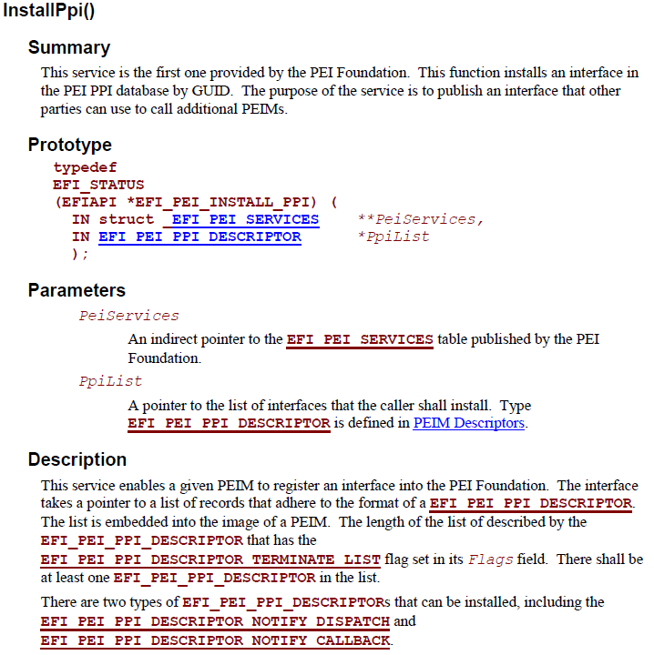
PPI Services
InstallPpi
ReInstallPpi
LocatePpi
NotifyPpi

Slide 8
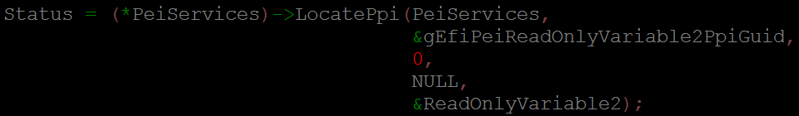
PPI Services

Slide 9
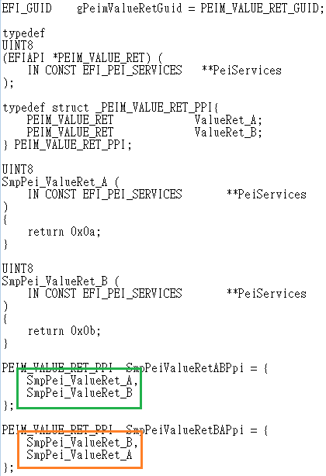
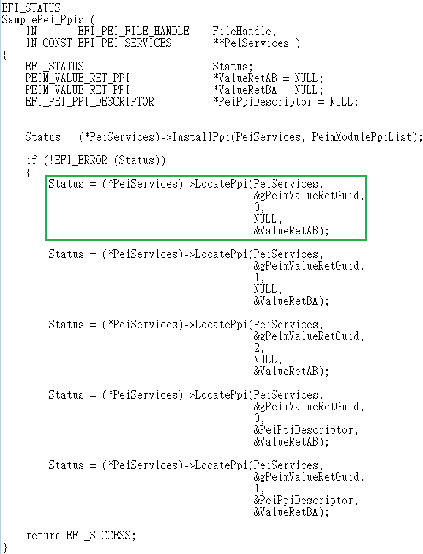
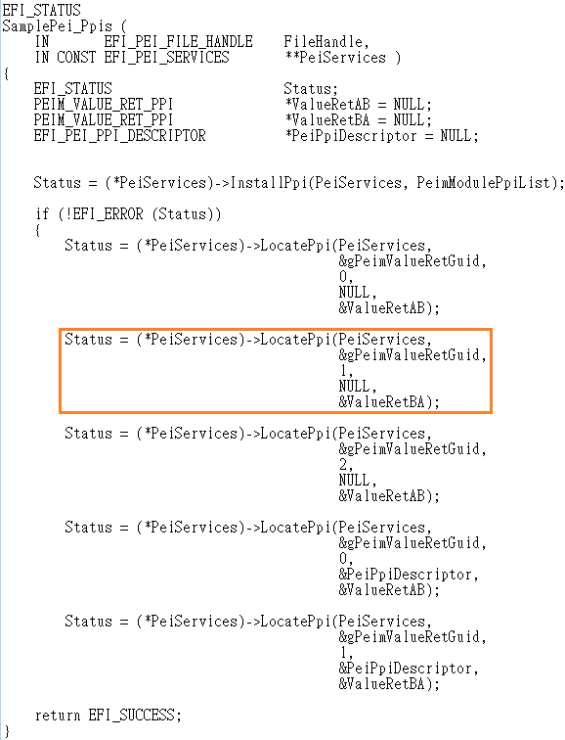
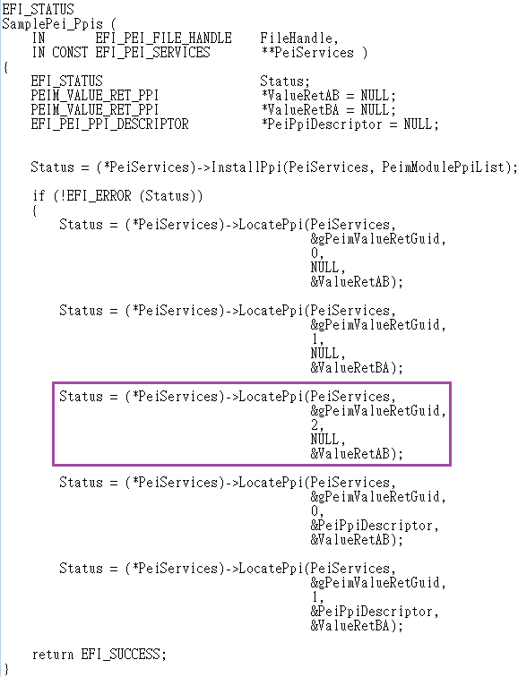
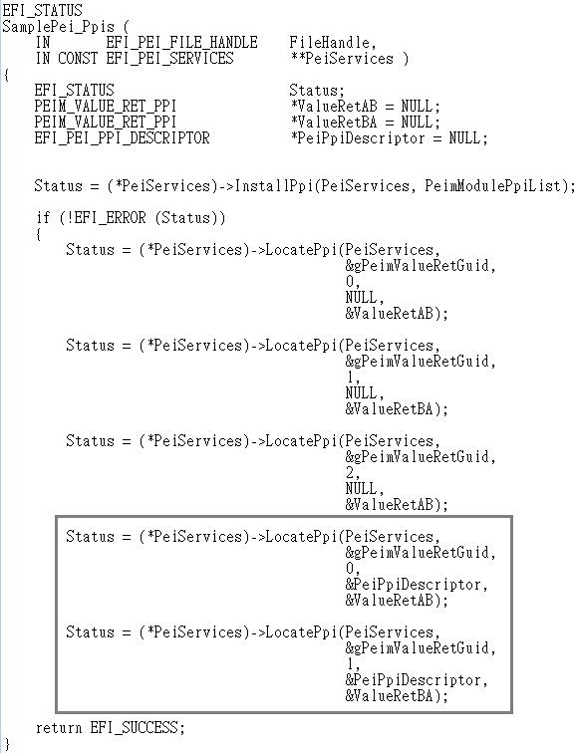
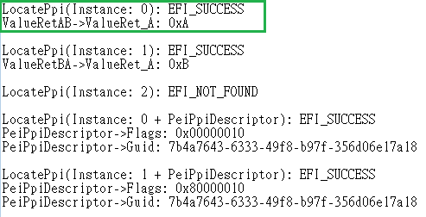
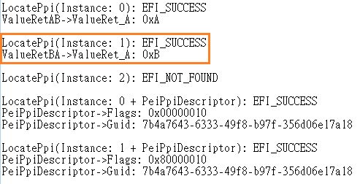
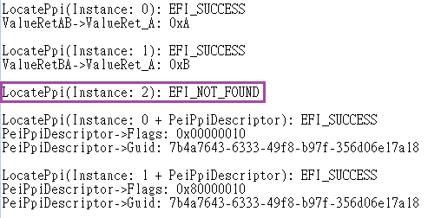
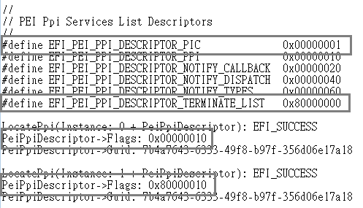
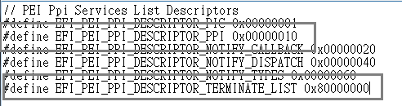
PPI Services

Slide 10
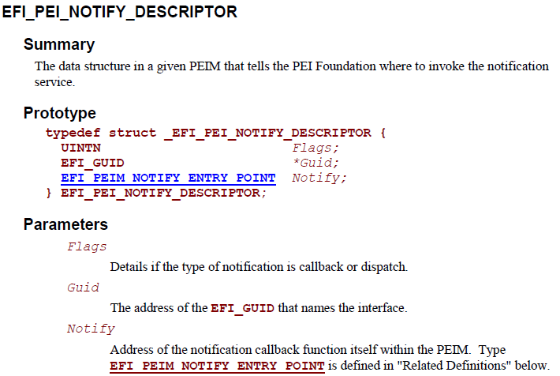
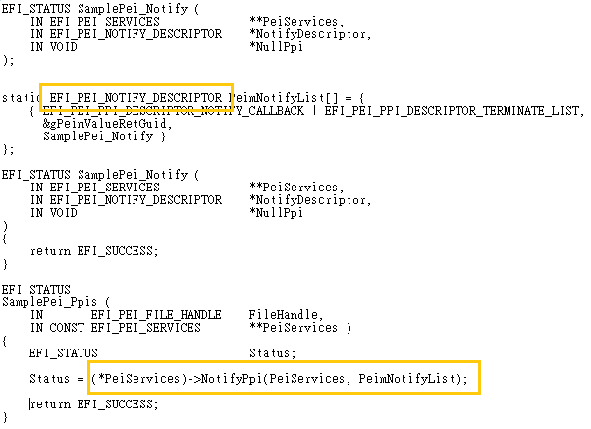
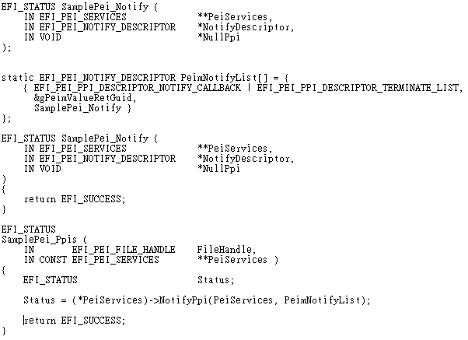
PPI Services

Slide 11
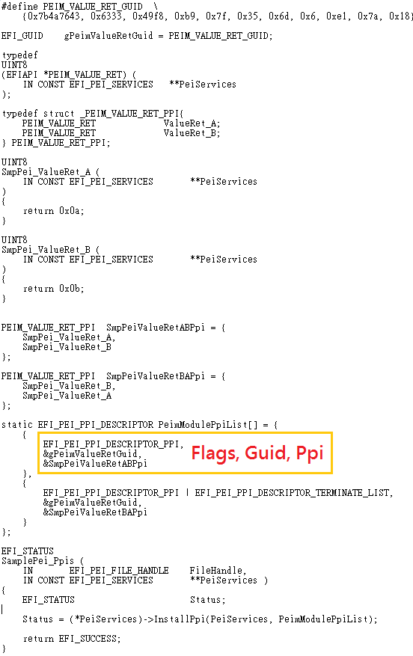
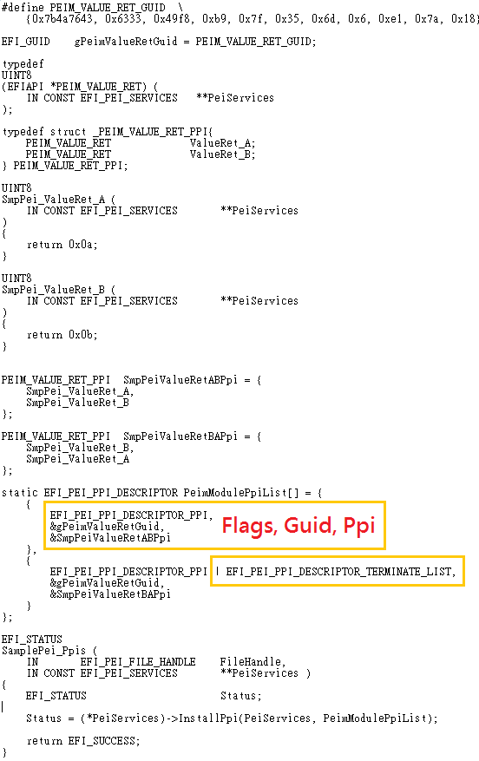
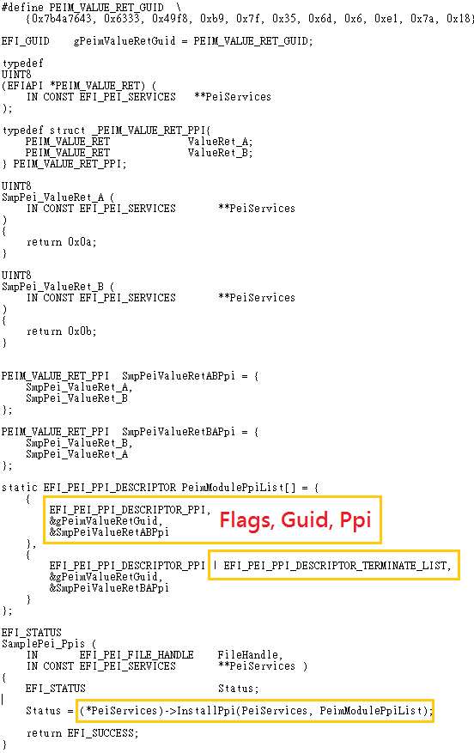
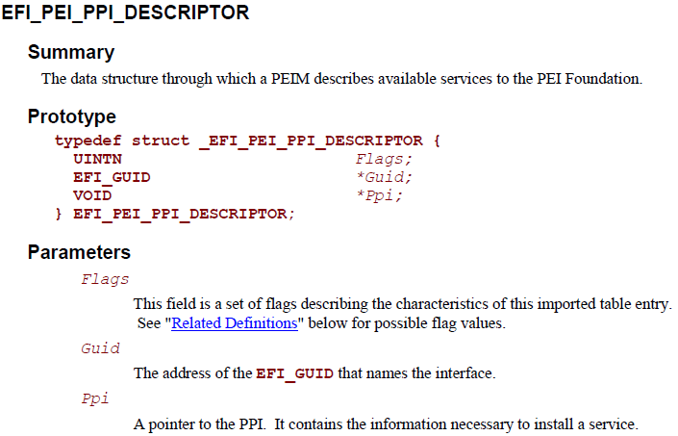
PPI Services

Slide 12
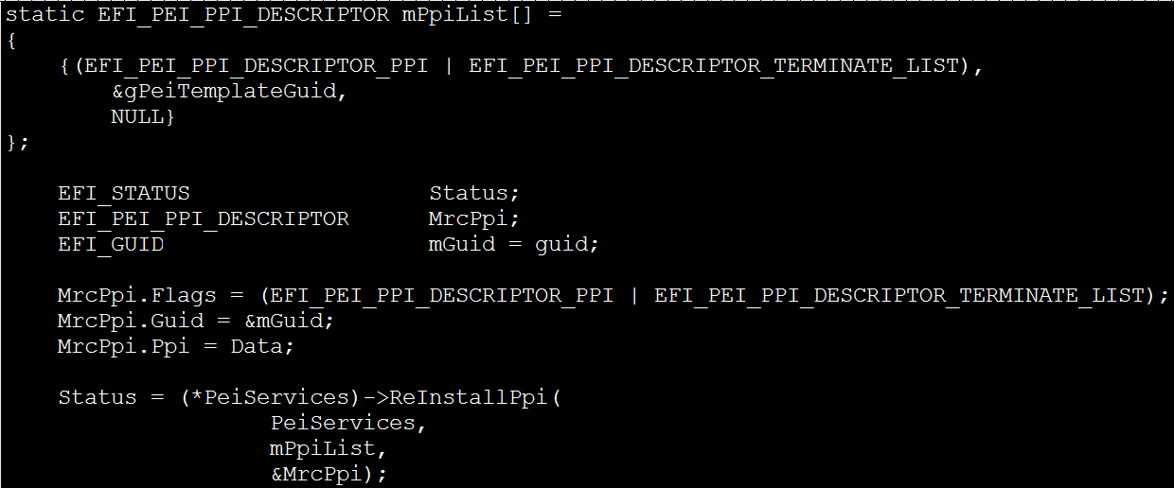
PPI Services

Slide 13
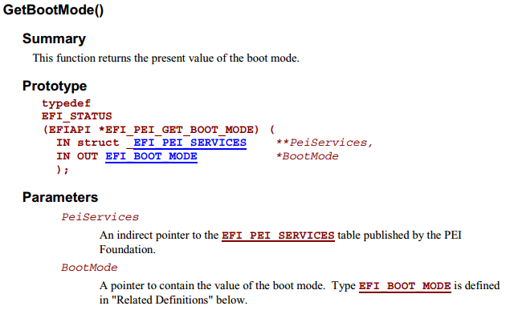
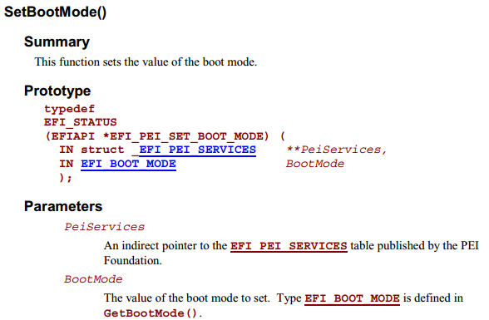
Boot Mode Services
GetBootMode
SetBootMode

Slide 14
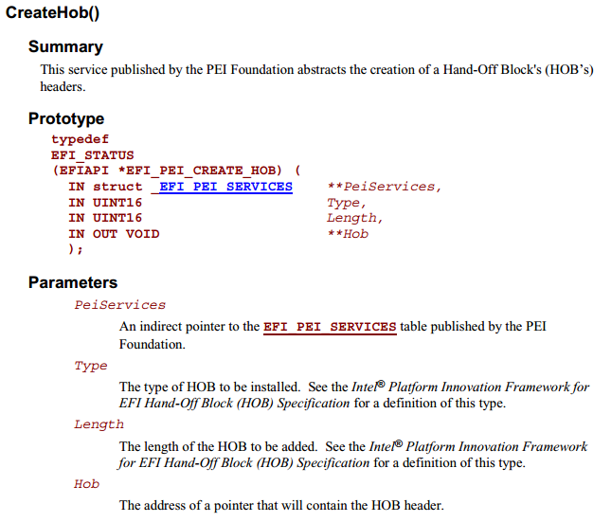
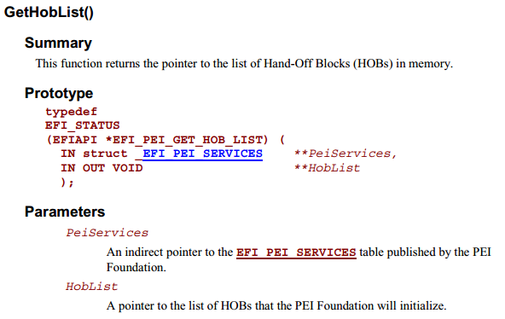
HOB Services
GetHobList
CreateHob

Slide 15
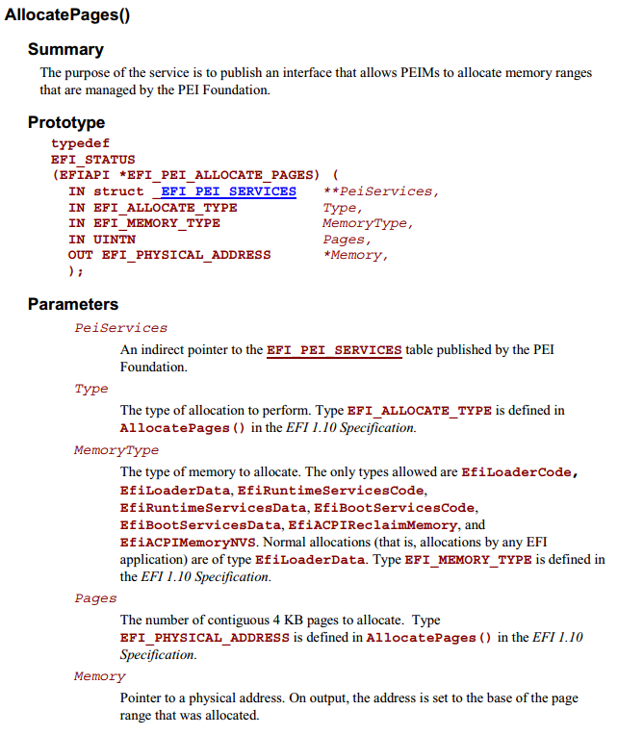
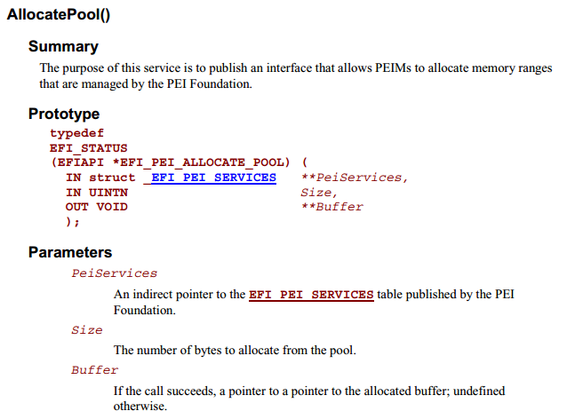
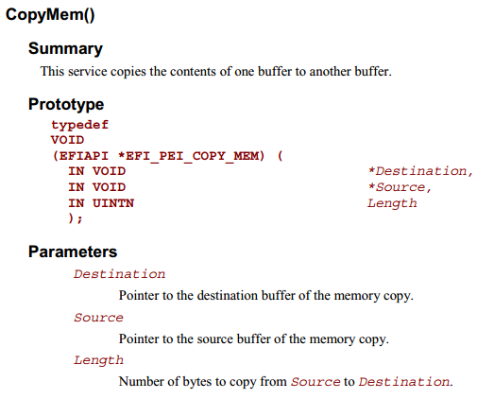
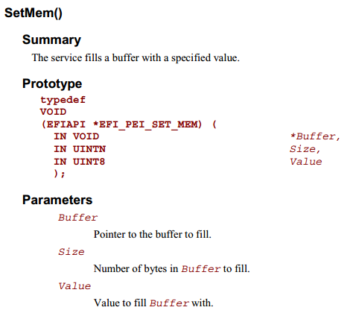
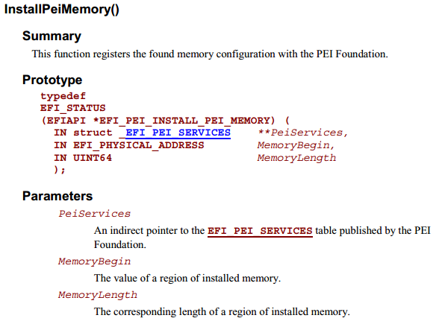
PEI Memory Services
InstallPeiMemory
AllocatePages
AllocatePool
CopyMem
SetMem

Slide 16
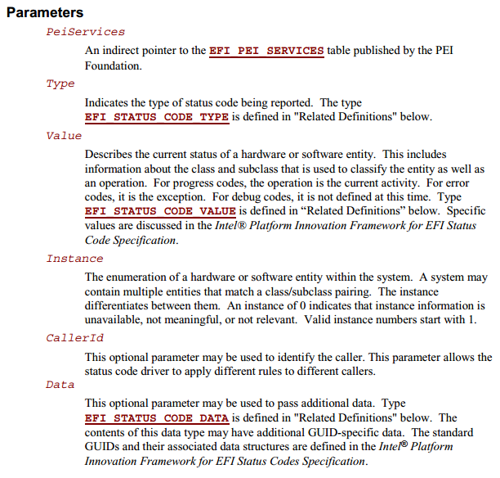
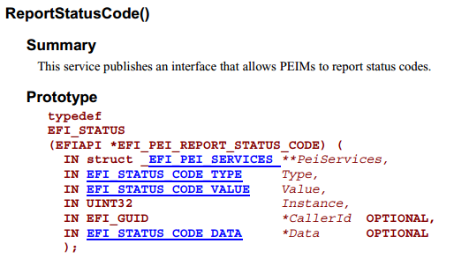
Status Code Services

Slide 17
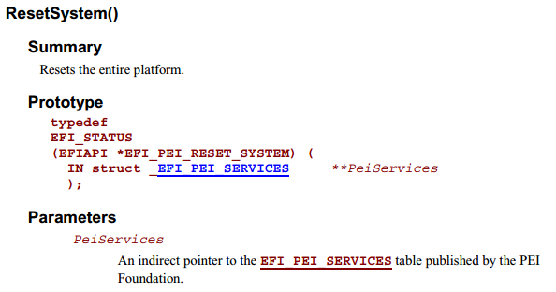
Reset Services

